Slide 1
Design Updates: Kami 3
Zach Dubinsky, Khai Dong, Jack Collins

Slide 2
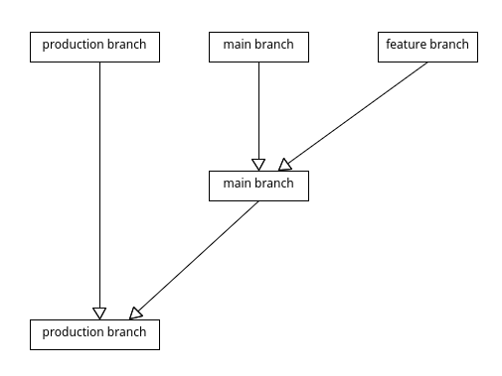
Git Management
GitLab Flow
Production Branch
Stable release branch
Main Branch
Stable, ahead of prod
Feature Branches
Unstable, ahead of main
Test “Branch”
Write directly to main

Slide 3
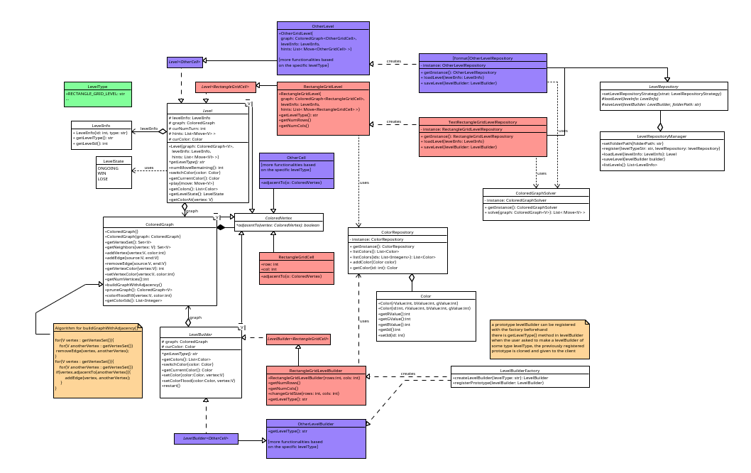
Refactoring Efforts

Slide 4
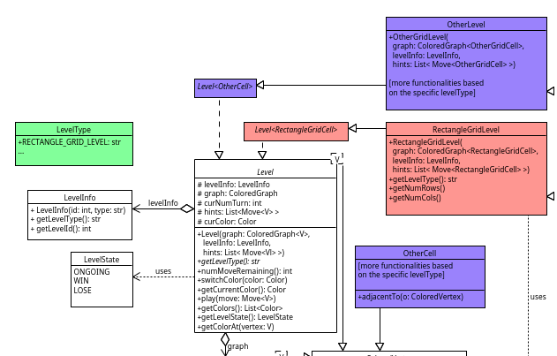
Level

Slide 5
Refactoring Efforts

Slide 6
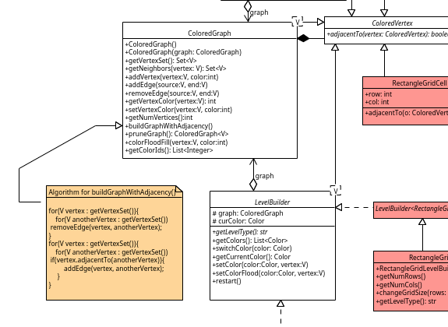
Colored Graph

Slide 7
Refactoring Efforts

Slide 8
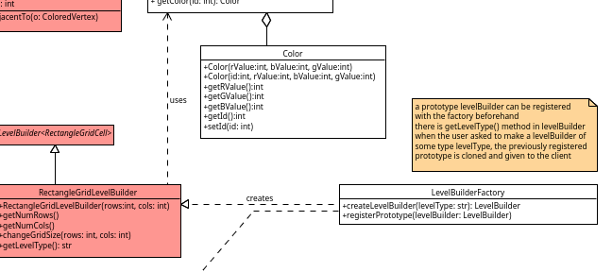
Builder

Slide 9
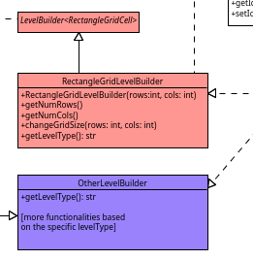
Builder cont.

Slide 10
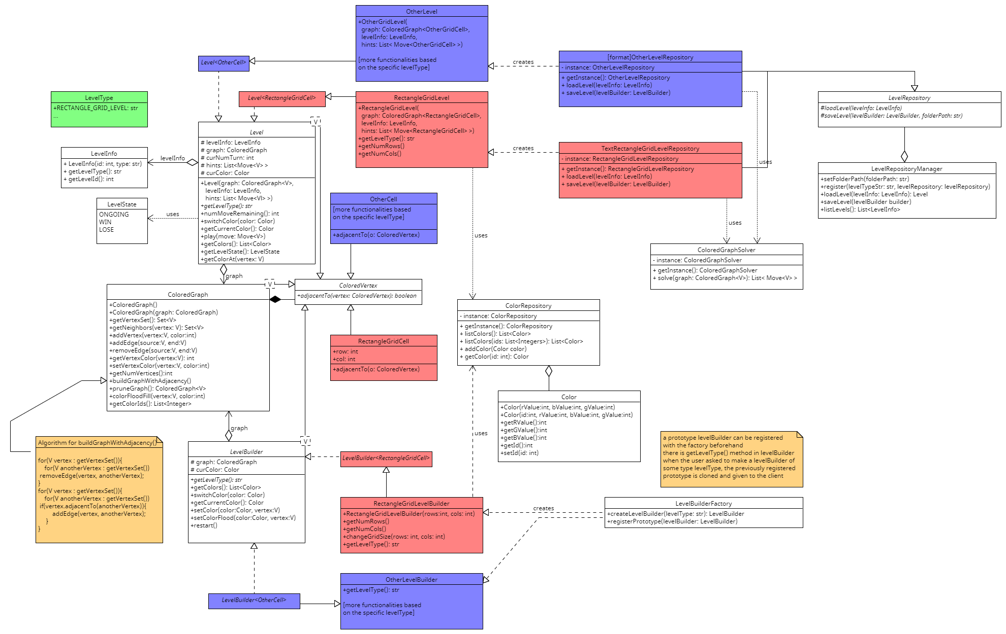
Refactoring Efforts
Strategy Pattern
File I/O
Different shapes
Factory Method Pattern
Construction of levels being wrapped into a single method
Notes:
The strategy LevelRepository is to register the type of the level so that it is loaded correctly and the view can use it correctly. File I/O strategy handles how the files will be written and read.

Slide 11
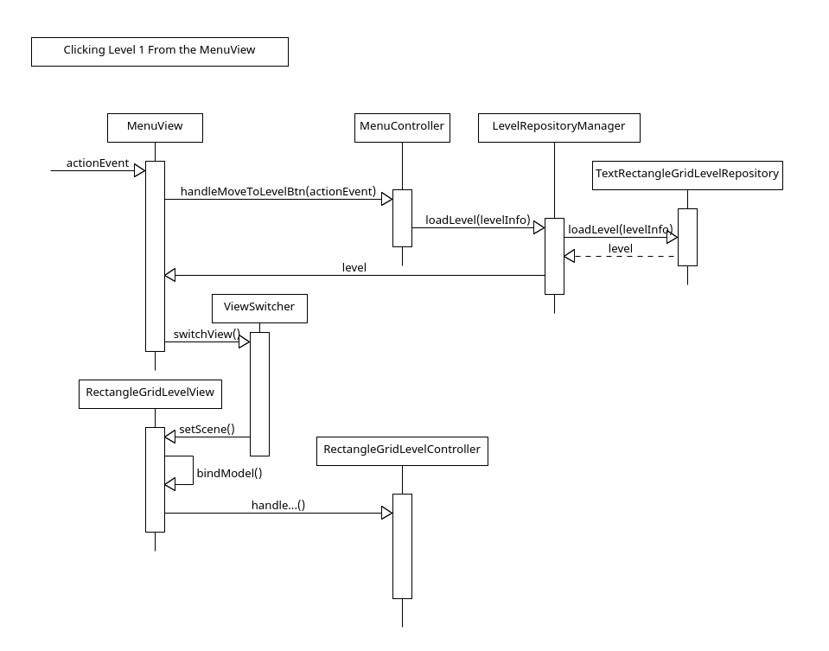

Slide 12
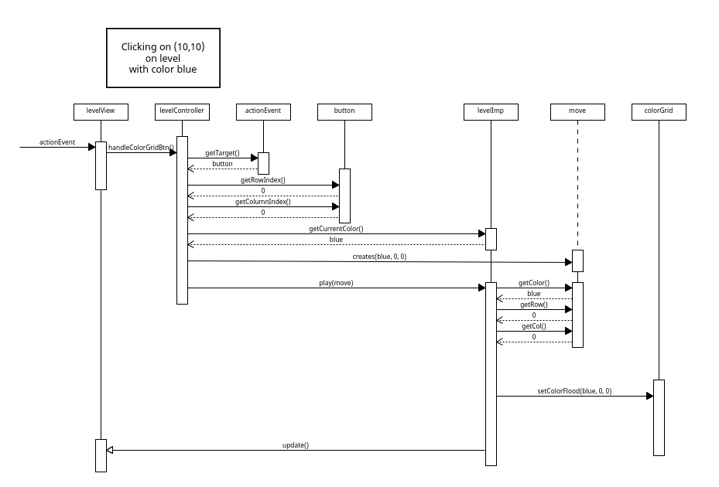

Slide 13
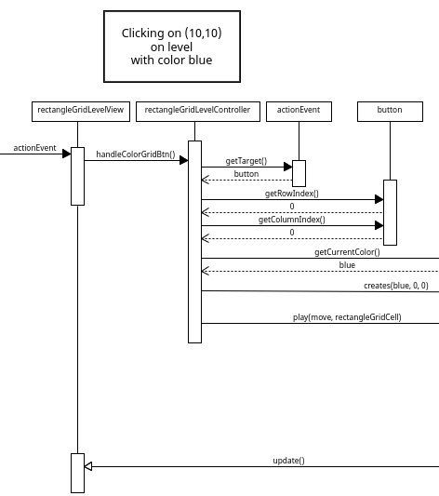

Slide 14
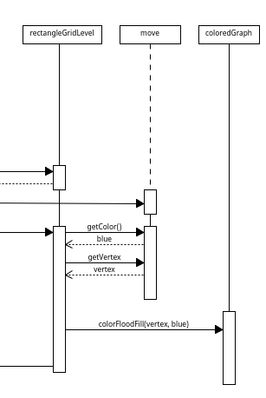

Slide 15
